Slide 1
LENDING CLUB CASE STUDY SUBMISSION
Name:
Amar Parsekar (Group-Facilitator)
Snehal Gupta

Slide 2
Problem Statement
Business Understanding: You work for a consumer finance company which specialises in lending various types of loans to urban customers. When the company receives a loan application, the company has to make a decision for loan approval based on the applicant’s profile. Two types of risks are associated with the bank’s decision:
If the applicant is likely to repay the loan, then not approving the loan results in a loss of business to the company
If the applicant is not likely to repay the loan, i.e. he/she is likely to default, then approving the loan may lead to a financial loss for the company.
When a person applies for a loan, there are two types of decisions that could be taken by the company:
Loan accepted: If the company approves the loan, there are 3 possible scenarios described below:
Fully paid: Applicant has fully paid the loan (the principal and the interest rate)
Current: Applicant is in the process of paying the instalments, i.e. the tenure of the loan is not yet completed. These candidates are not labelled as 'defaulted'.
Charged-off: Applicant has not paid the instalments in due time for a long period of time i.e. defaulted on the loan
Loan rejected: The company had rejected the loan
Business Objectives
Identify driving factors (or driver variables) behind loan default, i.e. the variables which are strong indicators of default.

Slide 3
Flow Chart
Business and Data Understanding
-Understanding the problem statement
-Understanding data source
Segmented Univariate Analysis
-perform segmentation on default rate and perform univariate analysis on categorical and derived variables.
Data Cleaning
-Delete: Rows with null entries and columns not required for analysis. Row with “Current” loan status.
-Impute: Median in outliers for annual income, Change Data types.
-Standardize values
Business Decision
-Recommend the company which are variables that are likely to default.
Bivariate Analysis
-Find combination of variables which have high default rate.
Driver variables
Based on analysis done, conclude on driver variables that affect default rate.
Derived Metrics
Derive categorical variables from numeric variables for:-
Interest rate, annual income, loan amount, DTI,
Univariate Analysis
-Perform univariate analysis on continuous and categorical variables to understand the distribution of data.
Import Data
-Importing csv file
-Importing library

Slide 4
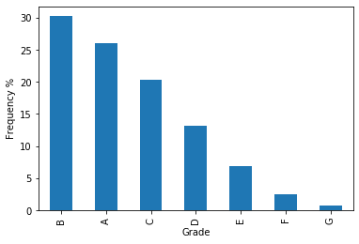
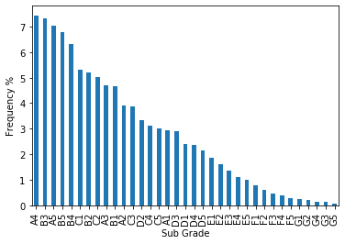
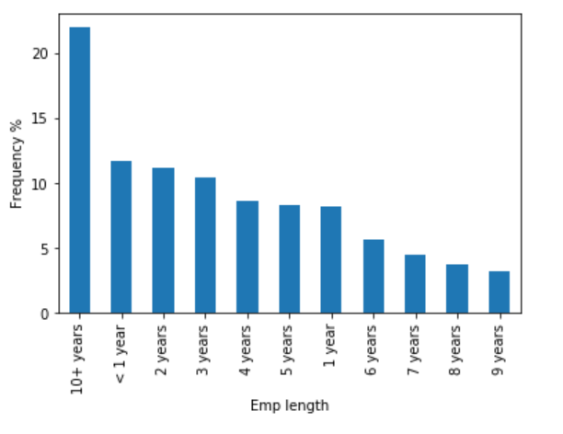
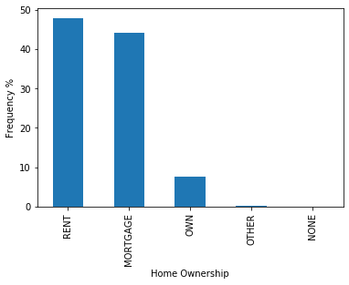
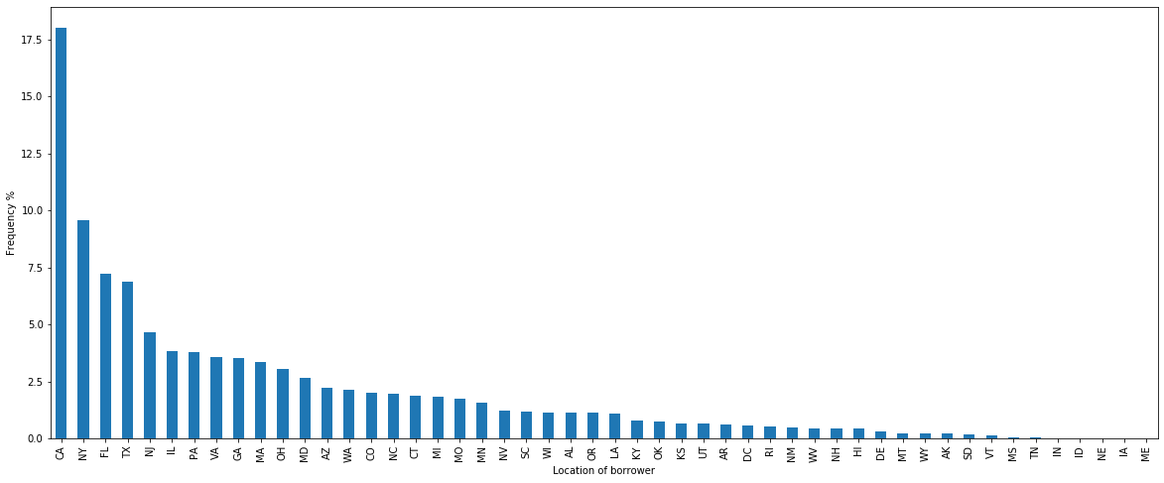
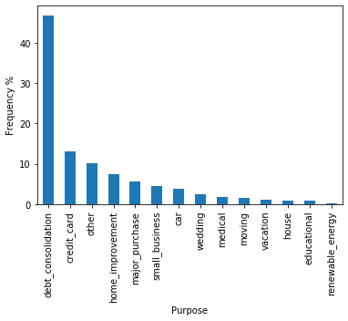
Univariate Analysis-Categorical Variables
Observations:
Majority applicants belong to CA state
Majority of applicants have taken loan for debt consolidation
Majority of applicants belong to grade B
Majority of applicants belong to sub_grade A4.
More than 40% applicants have rented home or mortgage
Majority applicants who have applied for loan have 10+ years

Slide 5
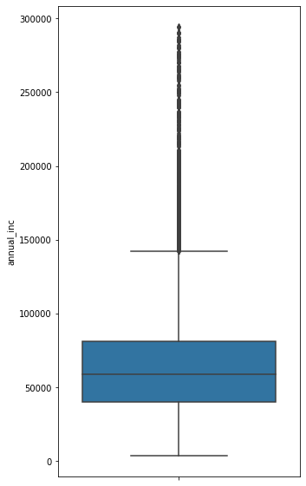
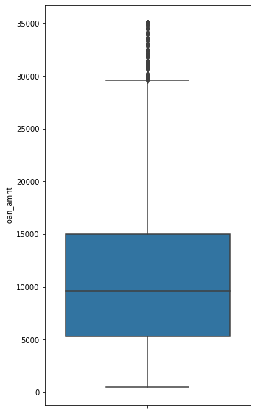
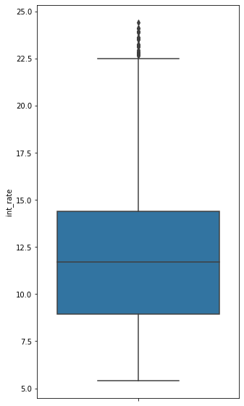
Univariate Analysis-Continuous Variables
Observations:
Majority of applicants have taken loan at 10 to 15% interest rate.
Most of the loan amounts are distributed between 8000 to 20000 USD.
Most of the applicants earns between 40000 to 90000 USD annually.

Slide 6
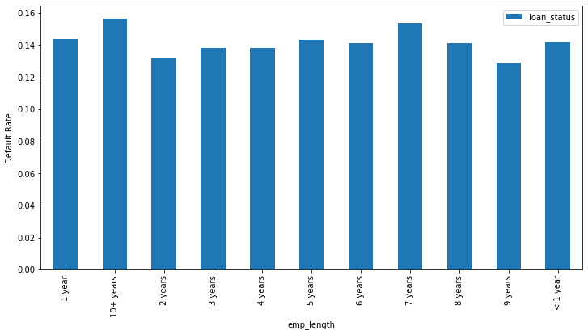
Univariate Segmented Analysis
Strategy: We performed univariate segmented analysis on demographic and loan characteristics.
Segmentation is done on default rate.
Default Rate= Number of defaults(Charged-Off)
Number of applicants
Plots:
Default Rate for Employee length
Employee length:
Applicants who have 10+ years or 1 year experience are more likely to default.

Slide 7
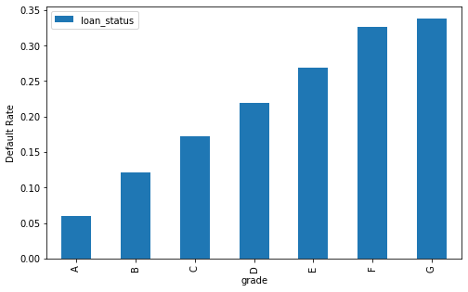
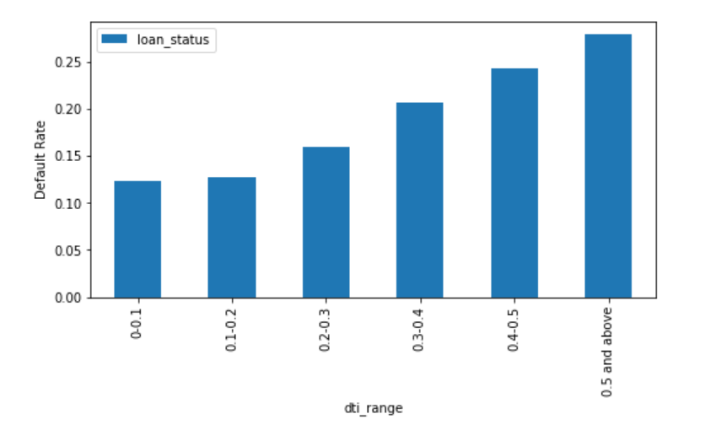
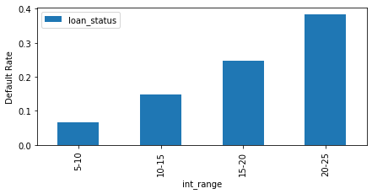
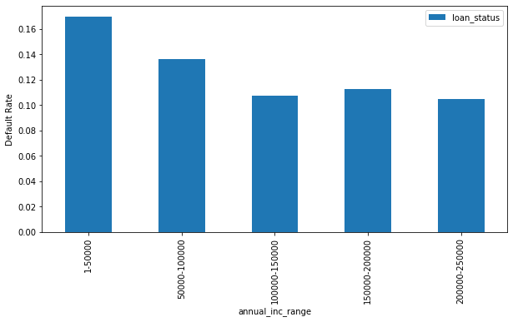
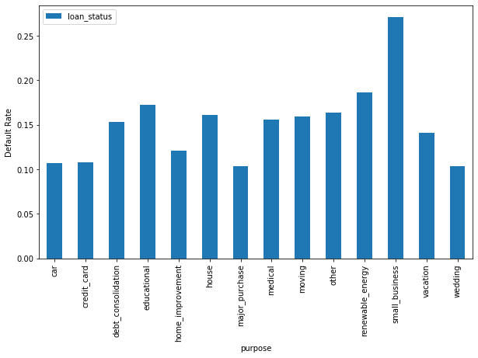
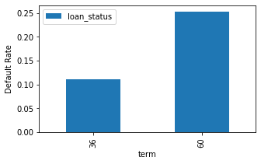
Default Rate for Grade
Default Rate for DTI
Default Rate for Interest Rate range
Grade:
Grade G applicants are more likely to default. Default Rate increases from grade A to G.
Interest rate:
As interest rate increases default rate increases.
DTI:
DTI is debt to income ratio.
As DTI increases default rate increases.
Default Rate for Annual Income Range
Default Rate for Purpose
Default Rate for Term
Purpose of loan:
Applicants who have taken loan for small business are more likely to be defaulters.
Term:
Default rate is high if loan is taken for longer term.
Annual Income:
Applicants who have annual income less than 50000 are more likely to default.

Slide 8
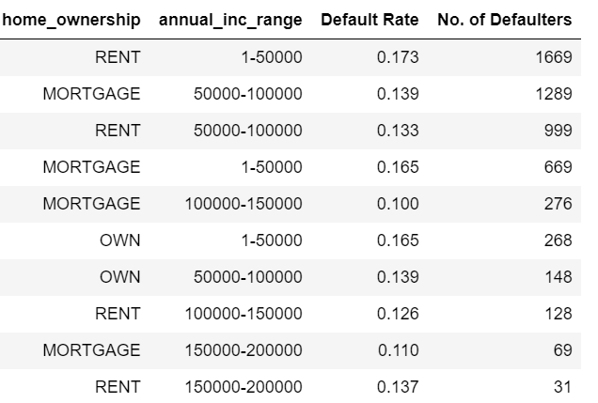
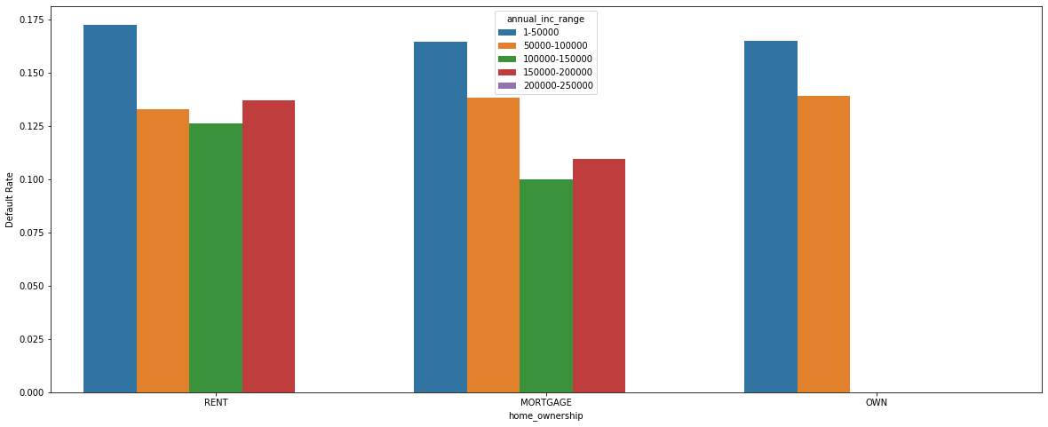
Bivariate Analysis
Strategy: We analysed various combinations of two variables against default rate and obtained top 3 combinations based on Number of defaulters greater than 1500 for the combination.
Assumption: Number of defaulters are considered because default rate is 1 even when there is only 1 defaulter applicant for the combination. Eg. Suppose Grade D3 and term 36mon has default rate 1. It is possible that there is only 1 applicant with this combination but default rate is still high hence number of defaulters is considered to extract top 3 combinations.
Plots:
Default Rate for Home ownership vs annual income
Observations:
Applicant with low income and rented home or mortgage are more likely to default.
Annual income range is less than 50000 and default rate is around 0.173

Slide 9
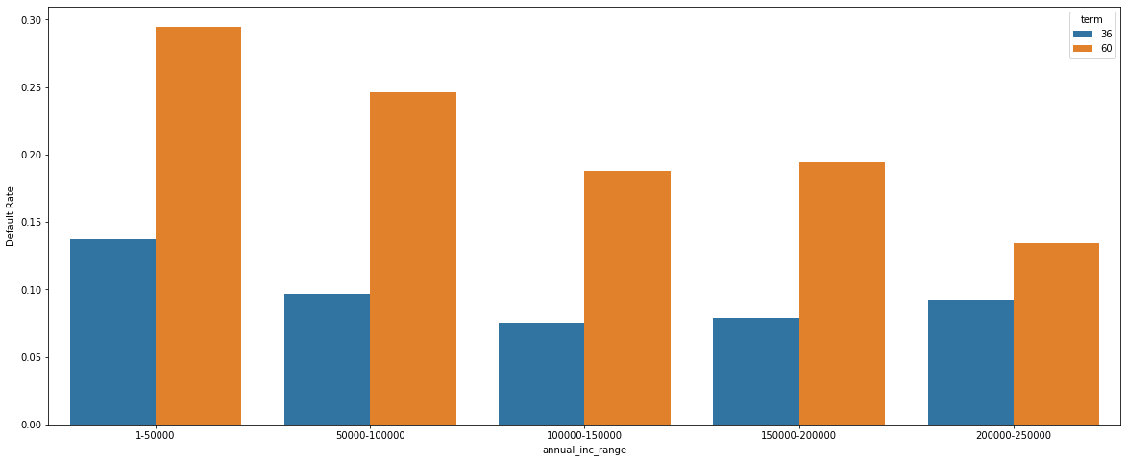
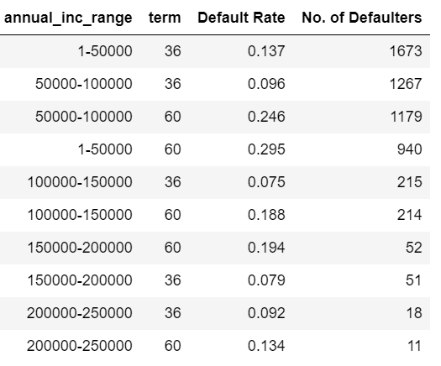
Default for Rate Annual Income vs Term
Top 10 Defaulters for Annual Inc Range vs Term
Observations:
Applicant with low income and loan taken for longer term are likely to default.
Default rate is around 0.137 .
Applicant who have taken loan for 60mon terms across all income brackets are likely to default compare to loan taken for shorter duration.

Slide 10
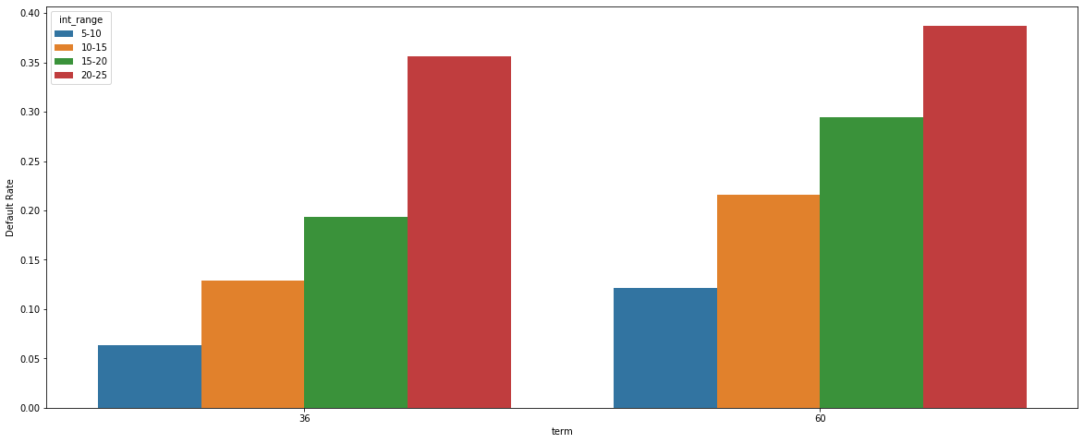
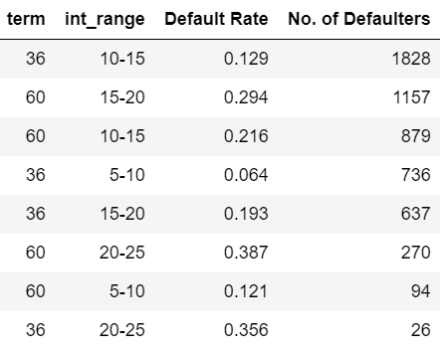
Default Rate for term vs interest rate
Top 10 Defaulters for Term vs Interest
Observations:
Applicant who have taken loan at high interest rate and for long term are likely to default.
Interest rate is around 20-25% , term is 60mon and default rate is around 0.129

Slide 11
Driver Variables & Recommendations
Driver Variables:-
Univariate & Segmented Univariate analysis- Purpose, Grade, Interest rate, Loan amount, Annual Income, Employee length, Verification status, Term, DTI, Sub-grade, Addr_state
Bivariate Analysis-Term vs Annual Income, Home ownership vs Annual Income, Term vs Interest rate range
Recommendations:
Lending club should take care while approving loan for applicants with any of the below variables as there are chances of default:-
Grade G applicants are more likely to default. Default Rate increases from grade A to G.
Applicants who have taken loan for small business are more likely to be defaulters.
Applicants who have low annual income (less than 50000) are more likely to default.
As interest rate increases default rate increases. Company needs to be careful while considering loan application at 20% and above interest rate.
Default rate is high if loan is taken for longer term. Company needs to be careful while considering loan application for 60 months.
As debt to income ratio increases there are high chances of default company should reject applicants with high debt income ratio.
Applicant with low income (less than 50000) and rented home or mortgage are more likely to default.
Applicant with low income (less than 50000) and loan taken for longer term (60mon) are likely to default.
Applicant who have taken loan at high interest rate (20% & above) and for long term(60mon) are likely to default.

